Slide 1
SPEECH EMOTION RECOGNITION
Student Details:
S.M.Vishnupriya (2018115133)

Slide 2
INTRODUCTION:
This project motivation is to detect emotions underlying in the speech that are recorded by analyzing the acoustic features of audio data of recordings and randomly suggest videos or motivational quotes or jokes or songs to make their mind pleasant.
Why we have chosen this project?
To develop knowledge about machine learning and to explore python language and its various libraries and functionalities.
To work with media recorder and audio files.
Learning various aspects and features of audio files.

Slide 3
Is your project available elsewhere? Give link and explain the related work.
https://drive.google.com/file/d/1mH43qYmbOFEdnfH2urGMIdPx5wwPDp75/view?usp=sharing
Here they Support Vector Machine is used as a classifier for
emotion recognition.
A Berlin Emotional database is used for feature
extraction and training SVM. The Berlin database of emotional
speech was recorded at the Technical University, Berlin. The
database contains speech with acted emotions in German
language. It contains 493 utterances of 10 professional actors five
males and five females who spoke 10 sentences with emotionally
neutral content in 7 different emotions.
Here in feature extraction process two features are extracted Mel Frequency
Cepstral Coefficient (MFCC) and Mel Energy spectrum Dynamic
coefficients (MEDC).

Slide 4

DESIGN:
Analyze
Audio file
Cleaning and masking of audio file
Feature extraction
Dataset audio
Feature extraction
prediction
Trained classifier
recording audio
Suggest video or quotes to boost your mindset
emotion

Slide 5
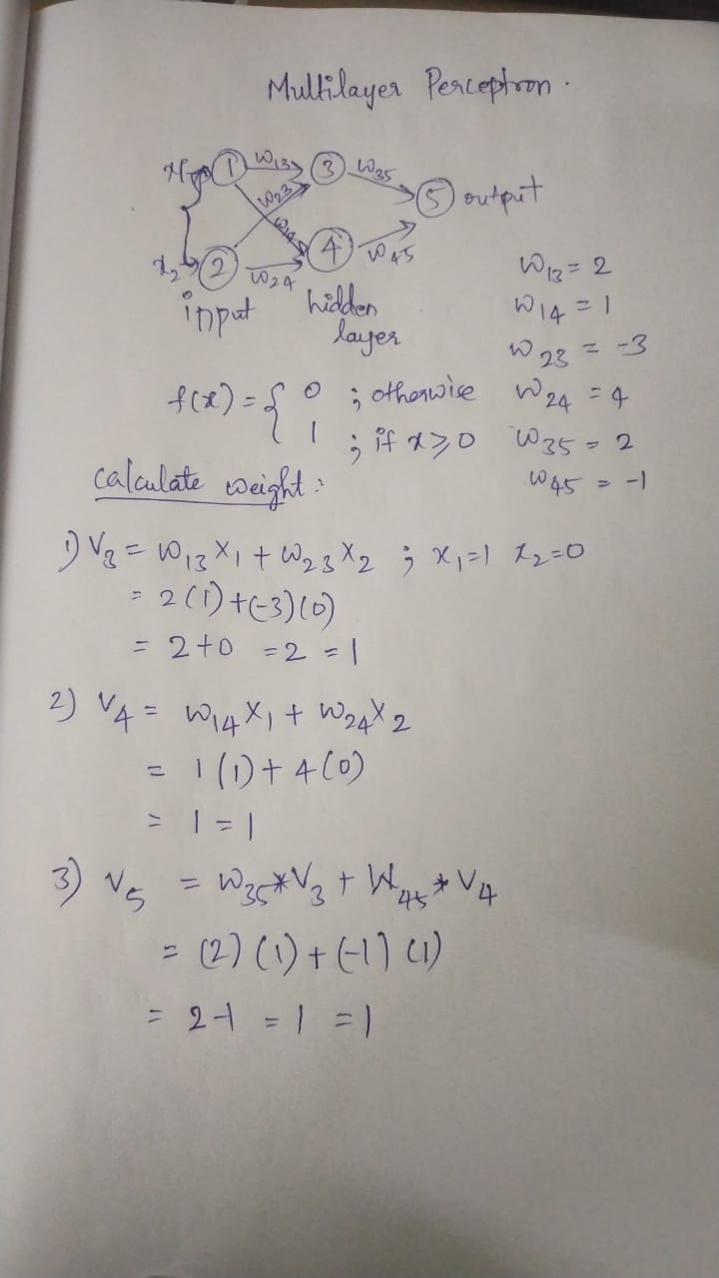
ALGORITHM:

Slide 6
model=MLPClassifier(alpha=0.01, batch_size=256, epsilon=1e-08, hidden_layer_sizes=(300,), learning_rate='adaptive', max_iter=500)
EXPLANATION:
max_iterint=500 Maximum number of iterations. The solver iterates until convergence (determined by ‘tol’) or this number of iterations. For stochastic solvers (‘sgd’, ‘adam’), note that this determines the number of epochs (how many times each data point will be used), not the number of gradient steps.
alphafloat=0.01 penalty (regularization term) parameter.
hidden_layer_sizestuple, length = n_layers - 2, (300,)The ith element represents the number of neurons in the ith hidden layer.
batch_sizeint, default=’auto’Size of minibatches for stochastic optimizers. If the solver is ‘lbfgs’, the classifier will not use minibatch. When set to “auto”, batch_size=min(256, n_samples)
epsilonfloat, default=1e-08 Value for numerical stability in adam. Only used when solver=’adam’

Slide 7
batch_sizeint, default=’auto’Size of minibatches for stochastic optimizers. If the solver is ‘lbfgs’, the classifier will not use minibatch. When set to “auto”, batch_size=min(256, n_samples)
epsilonfloat, default=1e-08 Value for numerical stability in adam. Only used when solver=’adam’
learning_rate{‘constant’, ‘invscaling’, ‘adaptive’},Learning rate schedule for weight updates effective_learning_rate = learning_rate_init / pow(t, power_t)‘adaptive’ keeps the learning rate constant to ‘learning_rate_init’ as long as training loss keeps decreasing. Each time two consecutive epochs fail to decrease training loss by at least tol, or fail to increase validation score by at least tol if ‘early_stopping’ is on, the current learning rate is divided by 5.Only used when solver='sgd'.

Slide 8
What is the portion you have completed so far?
50 percent
1.Voice recording module
2.Emotion Detect module
3.Web app integration
4.Model Training
5.Voice Feature Extraction.

Slide 9
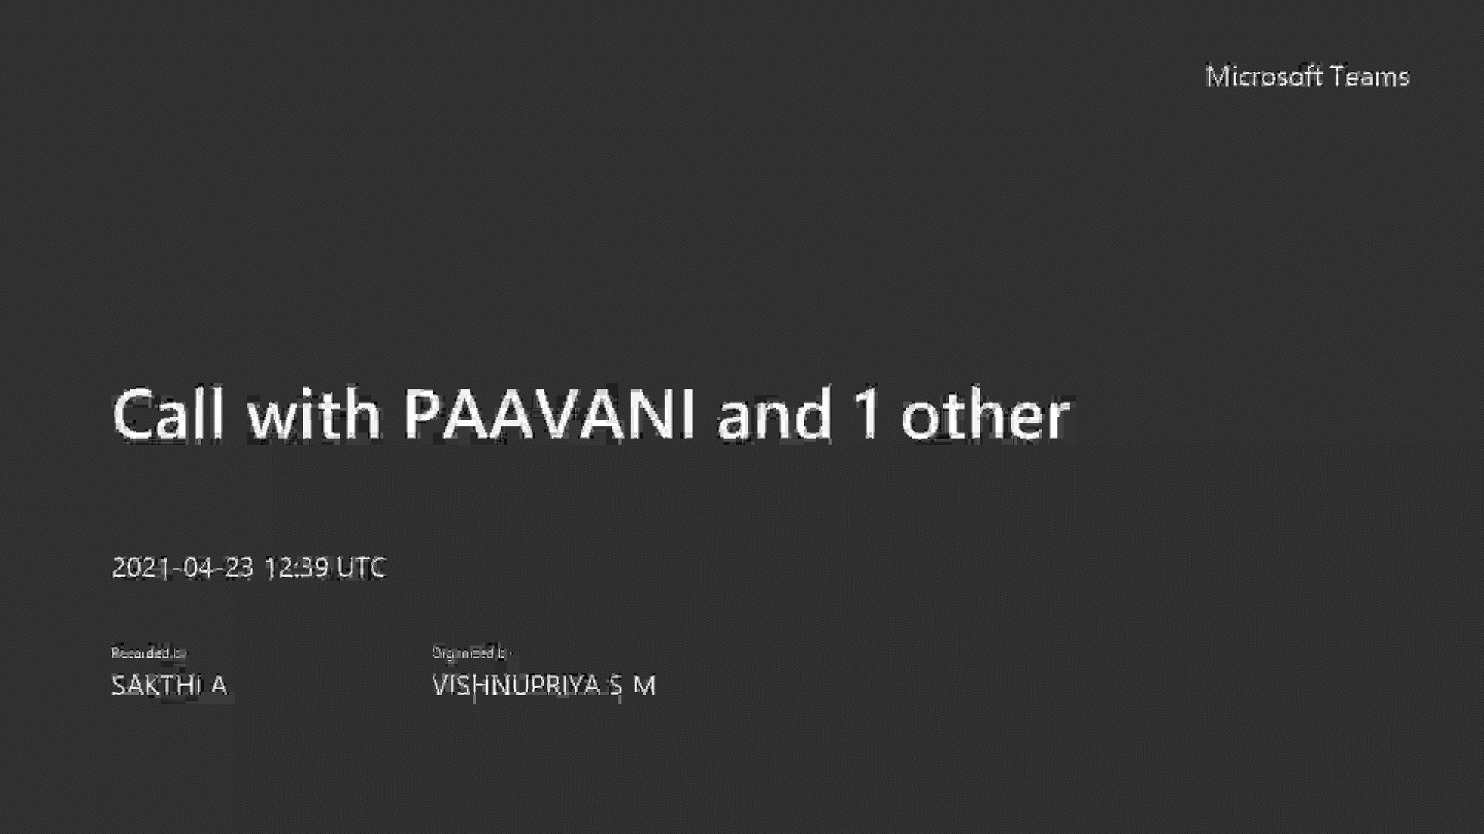
SHORT VIDEO: Link:https://drive.google.com/file/d/1riP4bDp3iNRy8Nul-tI77MQd-4cxp4Yl/view?usp=sharing

Slide 10
TASKS TO BE ACCOMPLISHED:
Feature Extraction
Emotion Detection
Model Training
Web app integration using node js
Voice recording using python
Model Training
Web app integration using flask
Voice recording using js
Model Training.

Slide 11
INNOVATION IN THIS WORK:
Assistance to detected emotions like suggestions or distraction.
Recording voice with particular characteristics in order to suit the trained model and to extract distinguished features from the recorded .wav file. Cleansing the recorded voice before feature extraction.
Using mel, mfcc and chroma as the basic characteristics to distinguish audio files. Using numpy library to generate array to predict the emotions from the speech.
Reduced noise and cleansing the dataset before training the model using MLP classifier.
The system is used to recognize the basic emotions: Calm, Happiness, Fearful, Disgust. It can serve as a basis for further designing an application for human like interaction with machines through natural language processing and improving the efficiency of emotion.
In depth visualization of audio files by plotting graphs for its certain features.

Slide 12
ARE YOU SATISFIED ON YOUR PROJECT?
Yes.
WHY?
We always tried to work collaboratively by conducting google meet so that each of us would have idea about every module about the project and the technical stuff.
We tried so many things, For example ,for recording voice we tried using java script and python and for integration we tried using node js and flask.
Cleared so many errors and tried different libraries to record voice with specific characteristics like mono channel and particular width, etc.
So, we are completely satisfied with our project as of now.

Slide 13
SELF EVALUATION:
25/25.

